Slide 1
sentiment analysis
T.Lakshmi Sowmya (20KN1A4456)
A.Snehika (20KN1A4402)
N.Chandu Teja (20KN1A4432)
Y.Samyuktha (20KN1A4462)

Slide 2
Introduction
Sentiment analysis refers to identifying as well as classifying the sentiments that are expressed in the text source.
Tweets are often useful in generating a vast amount of sentiment data upon analysis. These data are useful in understanding the opinion of the people about a variety of topics.
We need to develop an Automated Machine Learning Sentiment Analysis Model in order to compute the customer perception.

Slide 3
Problem statement
We try to implement a Twitter sentiment analysis model that helps to overcome the challenges of identifying the sentiments of the tweets.
The necessary details regarding the dataset are:
    The dataset provided is the Sentiment140 Dataset which consists of 1,600,000 tweets that have been extracted using the Twitter API.
    The various columns present in the dataset are: target, ids, date, flag, user and text

Slide 4
project pipeline
The various steps involved in the Machine Learning Pipeline are :
    Import Necessary Dependencies
    Read and Load the Dataset
    Exploratory Data Analysis
    Data Visualization of Target Variables
    Data Preprocessing
          Splitting our data into Train and Test Subset
          Transforming Dataset using TF-IDF Vectorizer
          Function for Model Evaluation
          Model Building
          Conclusion

Slide 5
data pre-processing
The punctuations were cleaned and removed thereby reducing the unnecessary noise from the dataset.
Also removed the repeating characters from the words along with removing the URLs
At last, we performed
  Stemming : reducing the words to their derived stems
  Lemmatization: reducing the derived words to their root form known as lemma for better results.

Slide 6
metrics used
We aim to analyze the sentiment of the tweets provided from the Sentiment140 dataset by developing a machine learning pipeline involving:
The three classifiers :
  Logistic Regression, Bernoulli Naive Bayes, and SVM
  Term Frequency- Inverse Document Frequency (TF-IDF)
The performance of these classifiers is then evaluated using:
  Accuracy and F1 Scores.

Slide 7
classifiers
Logistic Regression :
Logistic regression is used for solving the classification problems, it gives the probabilistic values which lie between 0 and 1.
Bernoulli Naive Bayes:
Bernoulli Naive Bayes is a variant of Naive Bayes. So, let us first talk about Naive Bayes in brief. Naive Bayes is a classification algorithm of Machine Learning based on Bayes theorem which gives the likelihood of occurrence of the event.

Slide 8
classifiers
SVM:
Support Vector Machine or SVM is one of the most popular Supervised Learning algorithms, which is used for Classification as well as Regression problems.
Term Frequency- Inverse Document Frequency (TF-IDF):
TF-IDF consists of two components, term frequency, and inverse document frequency.
Term frequency can be determined by counting the number of occurrences of a term in a document.
IDF is calculated by dividing the total number of documents by the number of documents in the collection containing the term.

Slide 9
evaluators
Accuracy:
Accuracy tells you how many times the ML model was correct overall. Number of correct predictions Total number of predictions.
Accuracy = TP+TN/TP+FP+FN+TN
F1 Scores:
The F1 score is defined as the harmonic mean of precision and recall.
F1 Score = 2*(Recall * Precision) / (Recall + Precision)

Slide 10
Applications
Customer satisfaction analysis
Public talk on a product or service or movie
Opinion poles
Market Research
Social medial monitoring

Slide 11
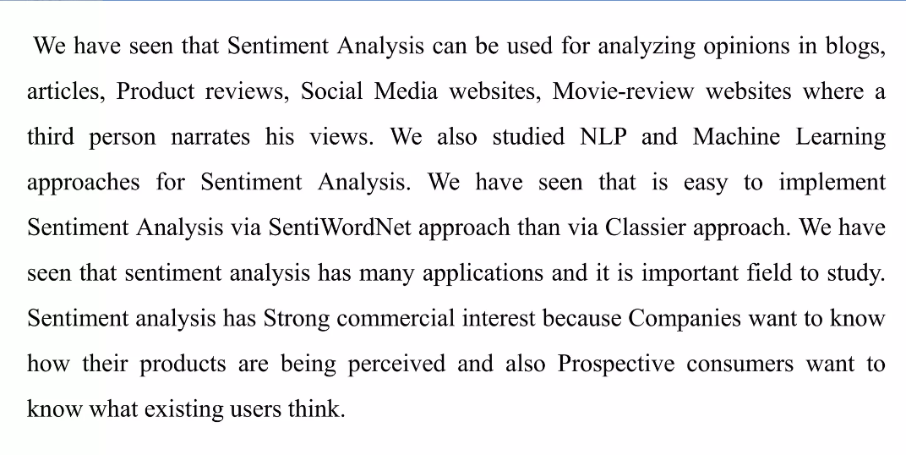
Conclusion

Slide 12

thank you

